Slide 1

IT-Amigos
A Nationwide platform, built by Nationwide, for you our Nationwide staff.
TEAM: HACK STREETS BACK
Sakeena Ali (ANALYST)
Sajahd Ali (TECH ANALYST)
Oliver Bird (EUS)
Philip Hadland (MAINFRAME ENG)
Rimma Chepik (SECURITY/CLOUD)

Slide 2
“A problem shared is a problem halved”
The concept came about from our personal experiences and listening to fellow TDP’rs in feedback sessions regarding our first 3 months of the program. Many had felt the learning process had been intense and due to the current Covid climate, having little face to face contact, the idea of reaching out to others felt intimidating.
So, we produced a simple but effective solution! Imagine a merging of both Facebook and Stack overflow, a social space related only to gaining or expanding your tech skills. A place where everyone from any sector of Nationwide can learn at there own pace, without pressure, without judgment, where you can ask for help to a very specific problem and receive the solution from internal NBS staff only. You can start at any level and work upwards, you can post about any areas of tech you're working on, be it Dev-ops, Software or even Hardware, work with others and grow your knowledge at a pace that suits you.

Slide 3
IT-Amigo’s Concept
User is a tech learner reaching out for solutions to a problem
Works on a ‘hivemind’ mentality utilising skills already within the business
A cross between Facebook and Stack Overflow but for NBS only
NBS employees can post tech problems and get technical solutions from within the business
Designed to be a safe space, no judgement, no pressure
Collaborators will get rewarded for helping to solve a problem for a user
App will be internal only and can make use of existing Azure Single Sign On
Post recent work, whether it be images or actual code like Github

Slide 4
Potential issues to User experience:
Misinformation
Off topic conversations in discussion threads
Miscommunication
Unverified users
Information overload
Time lag for solutions
User and information retention
Lack of posts/Lack of User interactions

Slide 5
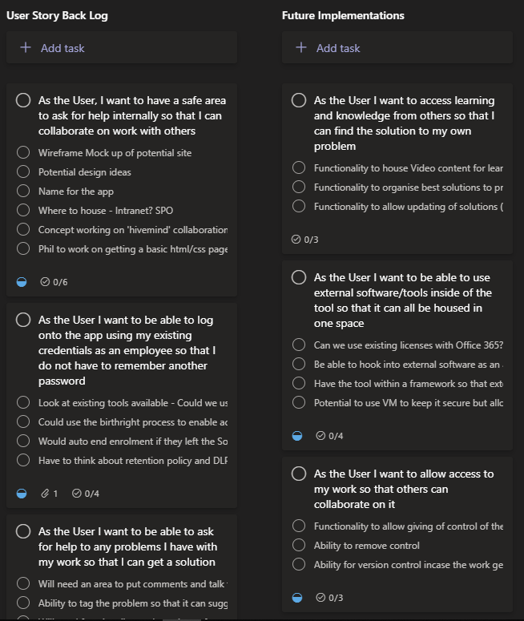
User Stories
Utilising Agile methods to put concept ideas into something a design team could work with
Having a mindset of being the user actually using the platform
Thinking about existing tools we already pay for a license that we can use
Start to conceptualise design and functionality
Prioritising work and what would need to be completed first
Working on value to the user, what do they want to achieve?
Potential things to consider - Conversations about DLP and Retention Policies

Slide 6
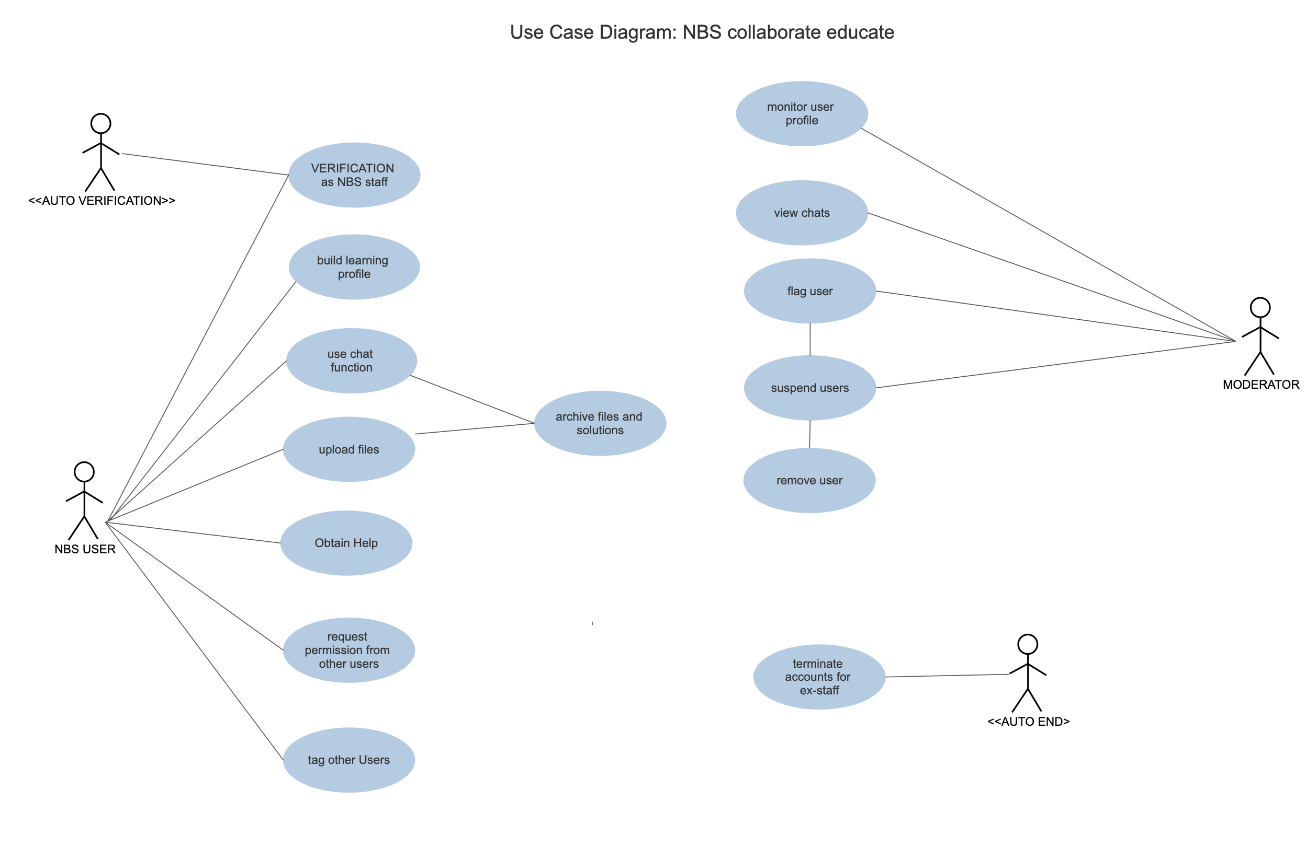
Utilising our Learning

Slide 7
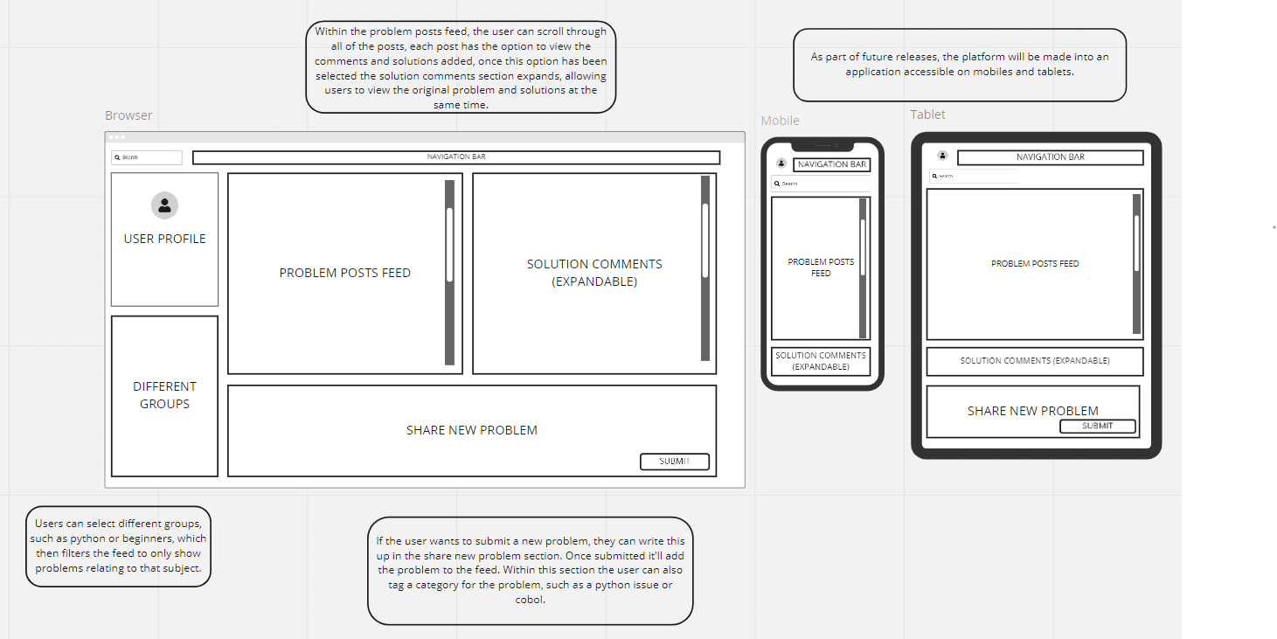
Wire Frame

Slide 8
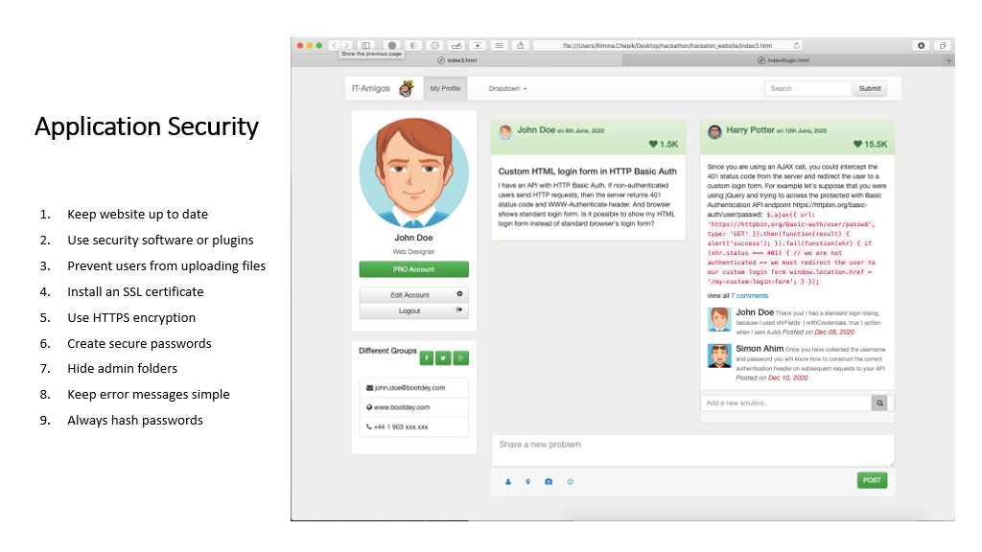
Platform Security

Slide 9
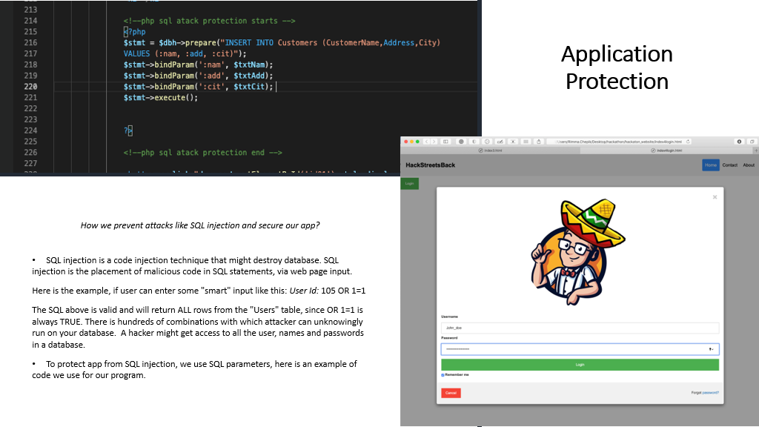
Platform Protection

Slide 10
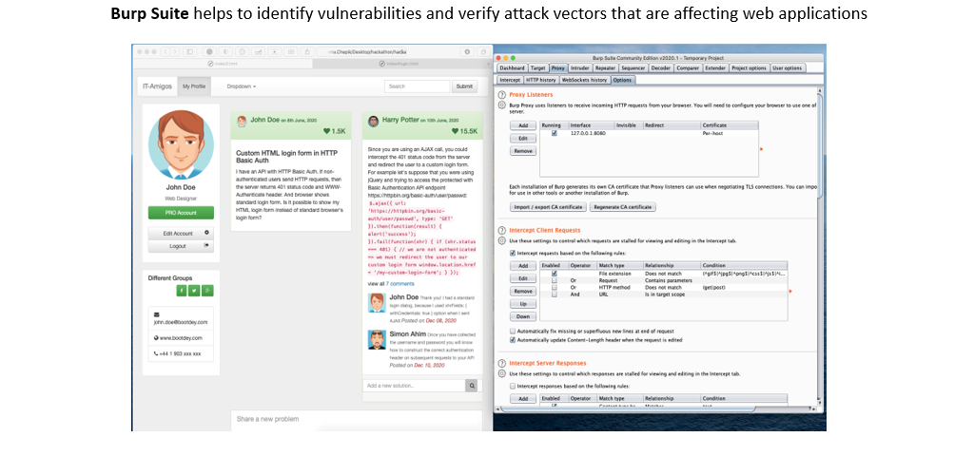
Platform Testing

Slide 11
Future Implementation Ideas
Expand
Become a learning platform, able to search answers look at knowledge articles
Value
Finding talent within Nationwide, reduce the costs of external hiring
Integration
Allow users to have a workspace in the app where they can hook into existing tools available

Slide 12
Thank you for listening!
Any Questions?

